Slide 1

CARS24: A Data-Driven
Business Case Study
Rishab Bansal | Data Analyst

Slide 2

Understanding Business
CARS24 operates in the highly competitive used-car market where pricing, inventory planning, and customer
demand vary significantly across brands, fuel types, ownership history, and vehicle specifications.
The business wanted to answer:
Which brands generate the highest revenue?
Which car segments should receive higher inventory investment?
What factors influence selling price?
Which customer segments dominate the used-car market?
How should inventory be optimized to maximize profitability?

Slide 3
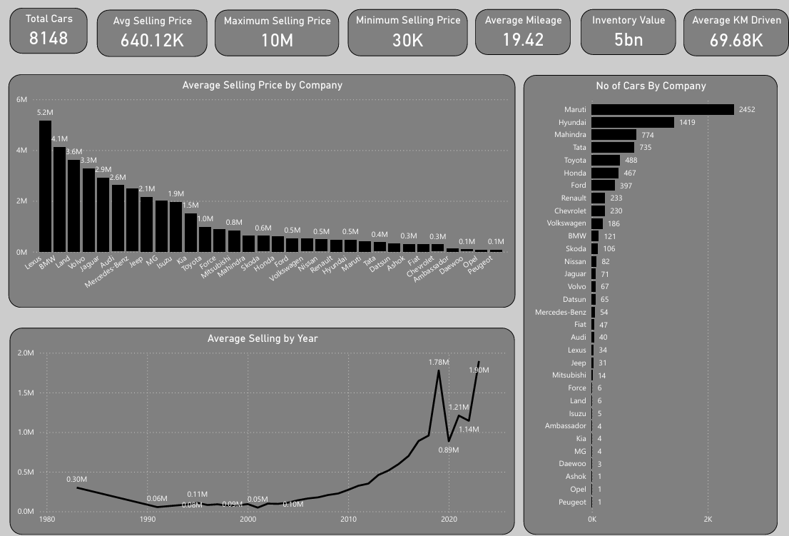
Executive Summary

Slide 4
MARKET COMPOSITION : Mass-Market Brands Drive Volume
Key Insights
Maruti (2,452) and Hyundai (1,419) alone account for 47% of all listings — the mass-market resale backbone.
The top 4 brands (Maruti, Hyundai, Mahindra, Tata) are all domestic marques, together forming over half the inventory.
Long tail of 28+ brands (BMW, Jaguar, Lexus, etc.) contributes volume in the single-to-triple digits — niche, high-value supply.

Slide 5
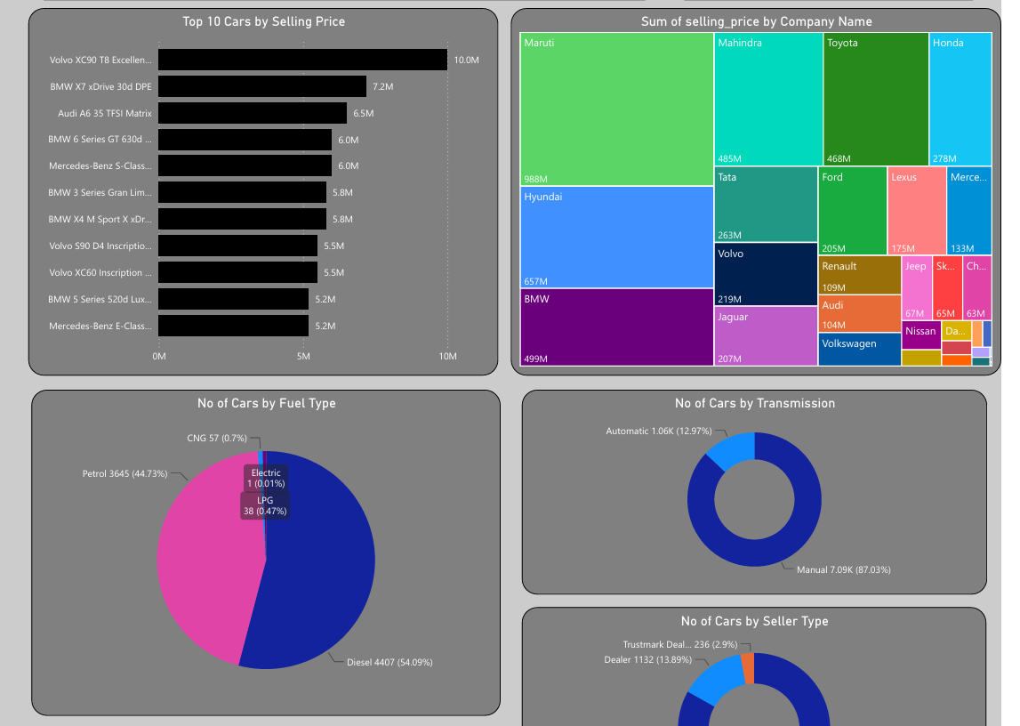
REVENUE CONTRIBUTION : Volume Still Wins on Total Value
Key Insights
Maruti generates the single largest revenue pool (₹988M) purely on volume, despite a modest per-unit average price.
BMW ranks #3 in total revenue (₹499M) from just 121 units — the highest revenue-per-car ratio of any major brand.
A dual strategy emerges: scale economics on domestic brands, margin economics on premium imports.

Slide 6
PRICING INSIGHT: Luxury Imports Command a Price Premium
Key Insights
Brands with the lowest sales volume (Volvo, BMW, Mercedes) post the highest average selling prices — up to 17× the mass-market average — signalling a distinct premium resale segment.
European luxury SUVs and sedans (BMW, Volvo, Audi, Mercedes-Benz) — the true ceiling of the resale market.

Slide 7
INVENTORY PROFILE : Fuel Type & Transmission Mix
Key Insights
Diesel (54%) and manual transmission (87%) dominate supply. Automatic and electric/CNG/LPG vehicles remain a thin slice — a clear white-space opportunity as buyer preferences shift toward automatics.

Slide 8
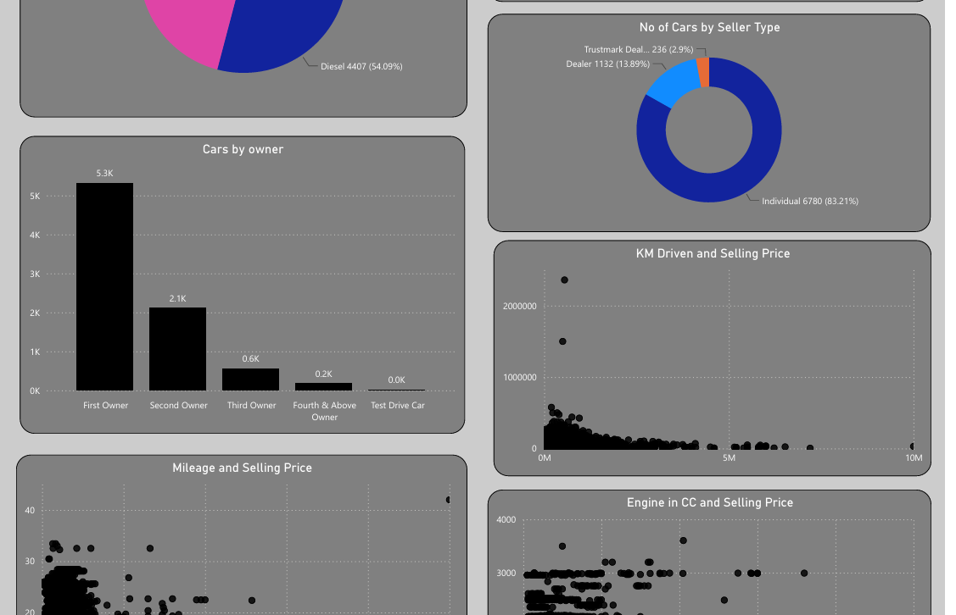
TRUST SIGNALS: Seller Type & Ownership History
Key Insights
:83% of listings come from individual sellers and 65% are first-owner cars — strong quality-trust signals that support CARS24's certified-inspection value proposition.

Slide 9
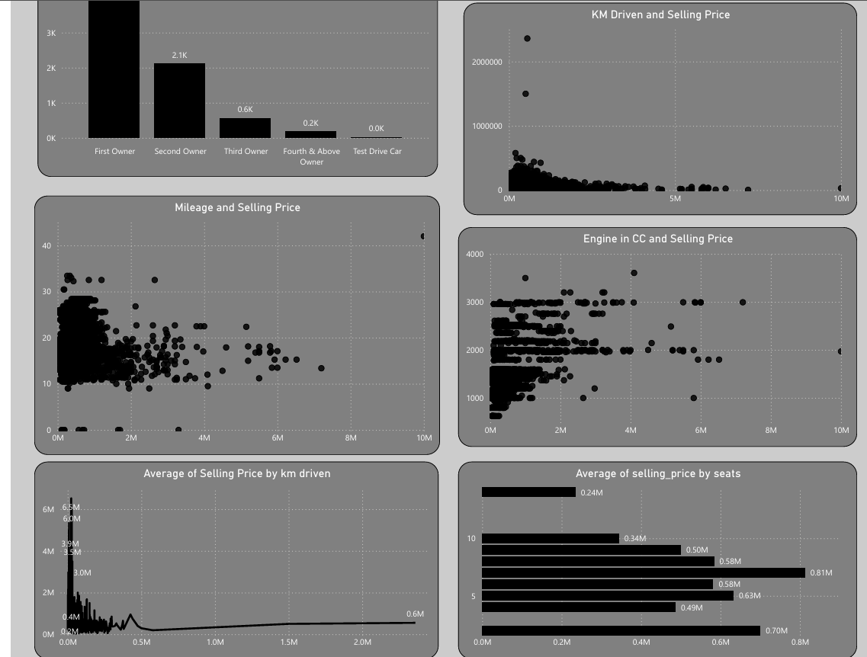
TRUST SIGNALS: Seller Type & Ownership History
Key Insights
Mileage vs. Price : Selling price trends downward as fuel-efficiency (mileage) rises — higher-mileage cars are typically smaller, older economy models, while low-mileage, high-performance vehicles fetch premium prices.
KM Driven vs. Price : Vehicles with lower odometer readings command consistently higher resale value; heavily driven cars (above the 69.68K average) see steep price erosion.
Engine Size vs. Price : Larger engine capacity (CC) correlates with higher selling price — bigger-engine SUVs and sedans anchor the top of the price band.
Seating Capacity vs. Price : 5-seaters average ₹0.5–0.8M while select 7–plus seat configurations reach ₹0.6–0.8M, reflecting demand for larger family and premium SUVs.

Slide 10
STRATEGIC RECOMMENDATIONS
Grow the premium-import segment : Actively source more BMW, Volvo, Audi and Jaguar units — they deliver the highest revenue-per-car and anchor a distinct margin-rich category.
Expand automatic & alternate-fuel stock : Automatic (13%) and electric/CNG/LPG (~1%) vehicles are underrepresented versus emerging buyer demand — an inventory gap worth closing.
Double down on trust-led selling : Lean into the 65% first-owner, 83% individual-seller base with certified inspection and ownership-history badges to justify pricing.
Price using usage-based models : Build dynamic pricing that weights KM driven, mileage and engine size, since these are the clearest levers of resale value observed in the data.
Protect the domestic volume engine : Maruti, Hyundai, Mahindra and Tata remain the revenue backbone — keep acquisition costs low and turnaround fast for these high-velocity segments.

Slide 11
Thank You
Rishab Bansal | Data Analyst

